Slide 1
20XC15 - Problem Solving and C Programming
Control Statements in C

Slide 2
Outline
Control statements
Selection/Branching
  Conditional
    If
    If else
    Nested if
    else if ladder
  Unconditional
    go to
    break
    continue
    return
Iteration/Looping
    for
    while
    do – while

Slide 3

Control Statements
The C programs presented until now follows a sequential flow of execution of statements
  Statements in a program are normally executed one after another until the last statement completes
  A C application begins executing with the first line of the main() function and proceeds statement by statement until it gets to the end of the main() function
Compound Statement a group of statements bracketed by { and } that are executed sequentially

Slide 4
Control Statements
Transfer of Control / Flow of control
  The order in which statements are executed in a running program
Control statements / structures control the flow of execution in a program or function
The C control structures enable to combine individual instructions into a single logical unit with one entry point and one exit point

Slide 5
Control Statements
Instructions are organized into three kinds of control structures to control execution flow
  Sequence
  Selection, and
  Repetition
Sequential Programming
  Normally, statements in a program are executed one after the other in the order in which they’re written
  The most straightforward control structure
  A list of what to do, step by step
  Example
    Addition of two numbers

Slide 6
Control Statements
Selection in Programming
  Some problem solutions require steps with two or more alternative courses of action
  A selection control structure chooses which alternative to execute
  Often programmed using if statements (simple if, if-else, nested if and else if ladder), or switch-case statement
  Allow different sets of instructions to be executed depending on the outcome of a logical test ‒ Whether TRUE or FALSE - Branching
For example: To Pack my bag for work
  Pack my PC
  Pack my money
  If it's raining
    Pack my coat

Slide 7
Control Statements
Repetition in Programming: (Also called as Iteration)
  Some applications may also require that a set of instructions be executed repeatedly, possibly again based on some condition - Looping
  Typically programmed using code such as while, do-while and for statements
  Repetition Vs Selection statements
    In selection, the condition is tested once
    In repetition, the condition is tested a number of times, every time the program decides whether to loop or not

Slide 8
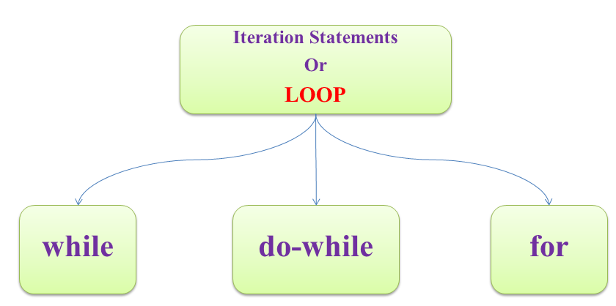
Iterative/Looping Statements in C
An iteration statement (also called as repetition statement or loop) allows you to specify that an action is to be repeated while some condition remains true
Each execution of the group of statements is called an iteration of the loop
Three Looping statements in C

Slide 9
Iterative/Looping Statements in C
Loop is a group of instructions the computer executes repeatedly while some loop-continuation condition remains true
Two means of iteration
  1. Counter-controlled iteration
  2. Sentinel-controlled iteration
Counter-controlled iteration - also called as definite iteration because we know in advance exactly how many times the loop will be executed
  In counter-controlled iteration, a control variable is used to count the number of iterations
  The control variable is incremented (usually by 1) each time the group of instructions is performed
  When the value of the control variable indicates that the correct number of iterations has been performed, the loop terminates and execution continues with the statement after the iteration statement

Slide 10
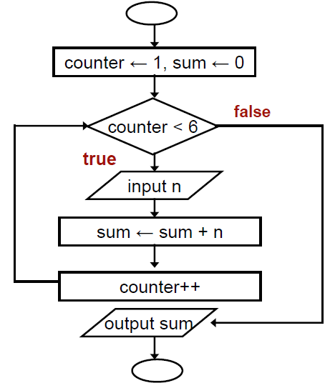

Iterative/Looping Statements in C
  Counter-controlled Loop
Read 5 integers and
display the value of their
summation

Slide 11
Iterative/Looping Statements in C
Sentinel-controlled iteration - also called as indefinite iteration because it’s not known in advance how many times the loop will be executed
  Sentinel values are used to control iteration when:
    1. The precise number of iterations isn’t known in advance, and
    2. The loop includes statements that obtain data each time the loop is
    performed
The sentinel value indicates “end of data.” The sentinel is entered after all regular data items have been supplied to the program
Sentinels must be distinct from regular data items

Slide 12
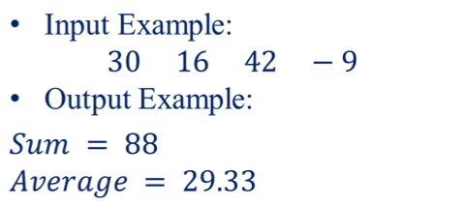

Iterative/Looping Statements in C
Example - Sentinel-controlled iteration
Receive a number of positive integers and display the summation and average of these integers
A negative or zero input indicates the end of input process
Input: A set of integers
ending with a
negative integer or a zero
Output: Summation and
Average of these integers
Sentinel
Value

Slide 13
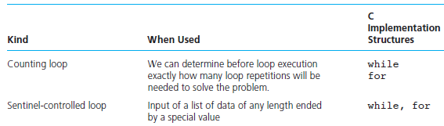

Iterative/Looping Statements in C
Comparison of Loop kinds

Slide 14
Iterative/Looping Statements in C
Three parts of a loop
    Initialization – done only once
    Condition – checked during each iteration until evaluates to false
    Iteration(updating of loop control variable) – updates the value of control variable
Two types of Loops
  Pre-test Loops – while, for
    In each iteration loop condition is tested, if it is true loop statements are executed otherwise the loop is terminated
  Post-test Loops – do…while
    The first iteration is executed without checking the loop condition. Then the loop condition is tested. If it is true next iteration starts, otherwise the loop is terminated

Slide 15
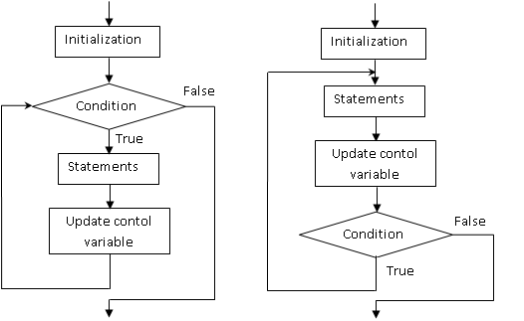
Iterative/Looping Statements in C
(a) Pre-test Loops (b) Post-test Loops

Slide 16
Iterative/Looping Statements in C
Entry Controlled / Pretest Loop (while, for) | Exit Controlled / Post-test Loop (do-while)
No of times of Execution Initialization 1 Loop condition test n+1 Updating of control variable n Body of loop(Max) n Body of loop(Min) 0 | No of times of Execution Initialization 1 Loop condition test n Updating of control variable n Body of loop(Max) n Body of loop(Min) 1

Slide 17
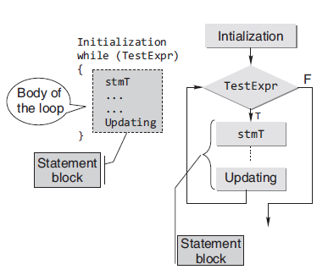
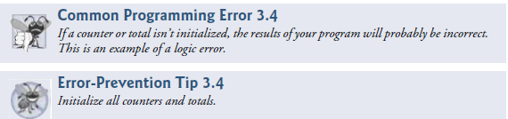
Iterative/Looping Statements in C
The while Statement
    while statement is a pre-test loop. The loop body will not be executed if the loop-control expression evaluates to false (zero)
Syntax
Initialization (1)
while ( expression (2) )
{ statements;
Update control variable(3)
}
statement x;

Slide 18

Iterative/Looping Statements in C
Initially, i=1
I iteration
1<=5 (true)
print 1
i=1+1=2
II iteration
2<=5 (true)
print 2
i=2+1 = 3
III iteration
3<=5(true)
print 3
i= 3+1 =4
IV iteration
4<=5 (true)
print 4
i=4+1=5
V iteration
5<=5 (true)
print 5
i=5+1 = 6
VI iteration
6<=5 (false)
Example 1:
Counter- controlled
#include<stdio.h>
int main()
{
int i=1;
while (i<=5)
{
printf(“%d”, i);
i++;
}
}
Output:
1 2 3 4 5
Initialization :1
Loop condition test :n+1
Update of control variable :n

Slide 19
Iterative/Looping Statements in C
Example 2
#include<stdio.h>
int main()
{
int i=1;
while (i<=5)
printf(“%d”, i);
i++;
}
Output : 1 1 1 1 1 1 1 …
(infinite number of times)
#include<stdio.h>
int main()
{
int i=1;
while(++i<=5);
printf("%d",i);
return 0;
}
Output : 6

Slide 20
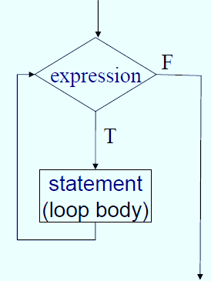
Iterative/Looping Statements in C
Example 3
#include<stdio.h>
int main()
{
int i=1;
while (1)
{
if (i<=5)
printf(“%d”, i);
else
break;
i++;
}
}
Note : break can be used to terminate the while loop

Slide 21
Iterative/Looping Statements in C
Example 4
#include<stdio.h>
int main()
{
while( )
printf("Hello world");
return 0;
}
Error : expected expression before ')' token
#include<stdio.h>
int main()
{
int i=1;
while(1)
{
printf("\t%d",i++);
if(i==5)
goto abc;
}
abc:
return 0;
}
Output : 1 2 3 4

Slide 22
Iterative/Looping Statements in C
Example 5 : Program to print a horizontal row of 10 asterisks
Version 1
#include <stdio.h>
int main()
{
int times = 0;
while (times < 10)
{
printf( “*”);
times++;
}
return 0;
}
Version 2
#include <stdio.h>
int main()
{
int times = 1;
while (times <= 10)
{
printf( “*”);
times++;
}
return 0;
}
Version 3
#include <stdio.h>
int main()
{
int times = 10;
while (times > 0)
{
printf(“*”);
times--;
}
return 0;
}
output : **********

Slide 23
Iterative/Looping Statements in C
Example 6 : Sentinel-controlled - Compute the average given the grades
#include <stdio.h>
int main()
{
unsigned int counter=1;
int grade;
int total = 0;
float average;
printf( "Enter grade, -1 to end: " );
scanf( "%d", &grade );
// loop while sentinel value not yet
read from user
while ( grade != -1) {
total = total + grade;
counter = counter + 1;
printf( "Enter grade, -1 to end: " );
scanf( "%d", &grade ); }
if ( counter != 0) {
average = (float) total / counter;
printf( "Class average is \n", average);
}
else {
puts( "No grades were entered" );
}
}

Slide 24
Iterative/Looping Statements in C
#include<stdio.h>
int main()
{
int age;
char ch=‘y’;
while (ch==‘y’ || ch==‘Y’)
{
printf(“ Enter you age”);
scanf(“%d”, &age);
if (age>17)
printf(“Eligible”);
else
printf(“Not eligible”);
printf(“Do u want to continue?(y - yes/n-no)”);
scanf(“%d”, &ch);
}
}

Slide 25
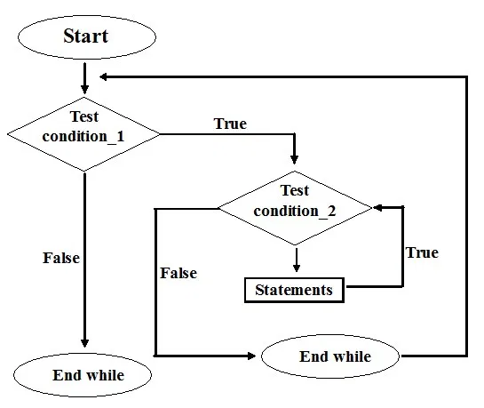

Iterative/Looping Statements in C
Nested while Loops
while(test_expression1)
{
statements;
while(test_expression2)
{
statements;
}
}

Slide 26
Iterative/Looping Statements in C
#include <stdio.h>
int main()
{
int i=1, j;
while (i <= 3)
{
j=1;
while (j <= i )
{
printf("%d ",j);
j++;
}
printf("\n");
i++;
}
return 0;
}
Output
1
1 2
1 2 3
Note:
For each iteration of outer loop, the inner loop is executed for i times

Slide 27
Iterative/Looping Statements in C
IV iteration – outer loop
4<=3 (false)
Initially, i=1
I iteration - outer loop
1<=3 (true)
j =1
I iteration – inner loop
1<=1 (true)
print 1
j=1+1=2
II iteration – inner loop
2<=1 (false)
i=1+1 =2
II iteration – outer loop
j =1
I iteration – inner loop
1<=2 (true)
print 1
j=1+1=2
II iteration – inner loop
2<=2 (true)
print 2
j=2+1 =3
III iteration – inner loop
3<=2 (false)
i=2+1=3
III iteration – outer loop
3<=3 (true)
j =1
I iteration – inner loop
1<=3 (true)
print 1
j=1+1=2
II iteration – inner loop
2<=3 (true)
print 2
j=2+1 =3
III iteration – inner loop
3<=3 (true)
print 3
j=3+1 =4
IV iteration – inner loop
4<=3 (false)
i=3+1 =4
#include <stdio.h>
int main()
{
int i=1, j;
while (i <= 3)
{
j=1;
while (j <= i )
{
printf("%d ",j);
j++;
}
printf("\n");
i++;
}
return 0;
}
Output
1
1 2
1 2 3

Slide 28
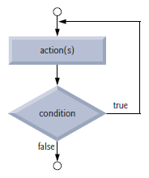
Iterative/Looping Statements in C
The do…while statement
  The do…while iteration statement is similar to the while statement
  In the while statement, the loop-continuation condition is tested at the beginning of the loop before the body of the loop is performed
  The do…while statement tests the loop-continuation condition after the loop body is performed. Therefore, the loop body will always execute at least once
  When a do…while terminates, execution continues with the statement after the while clause

Slide 29
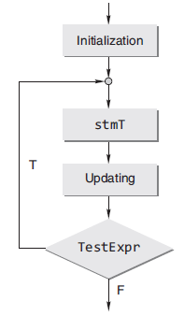
Iterative/Looping Statements in C
Syntax
    Initialization(1)
    do
    {
    statements;
    update control variable(3)
    } while(expression(2));
    statement x;
Execution proceeds as follows
The loop body is executed
Next, expression is evaluated
If expression is false, the do-while statement terminates and control passes to the next statement in the program. If expression is true (non-zero), the execution of statements in the loop body is repeated

Slide 30
Iterative/Looping Statements in C
Initially, i=1
I iteration
print 1
i=1+1=2
2<=5 (true)
II iteration
print 2
i=2+1 = 3
3<=5 (true)
III iteration
print 3
i= 3+1 =4
4<=5(true)
Example 1 : Counter-controlled
IV iteration
print 4
i=4+1=5
5<=5 (true)
V iteration
print 5
i=5+1 = 6
6<=5 (false)
#include<stdio.h>
int main()
{
int i=1;
do
{
printf(“%d”, i);
i++;
} while(i<=5);
}
Output:
1 2 3 4 5
Initialization :1
Loop condition test :n
Update of control variable :n

Slide 31
Iterative/Looping Statements in C
Example 2
#include <stdio.h>
int main()
{
unsigned int counter=0;
int grade;
int total = 0;
float average;
do
{
printf( "Enter grade, -1 to end: " );
scanf( "%d", &grade );
if (grade == -1)
break;
else
{ total = total + grade;
counter = counter + 1; }
} while (1) ;
if ( counter != 0) {
average = (float) total / counter;
printf( "Class average is \n", average);
}
else {
puts( "No grades were entered" );
}
}

Slide 32
Iterative/Looping Statements in C
#include<stdio.h>
int main()
{
int age;
char ch ;
do
{
scanf(“%d”, &age);
if (age>17)
printf(“Eligible”);
else
printf(“Not eligible”);
printf(“Do u want to continue?(y/n)”);
scanf(“%c”, &ch);
} while (ch== ‘y’ || ch==‘Y’);
}

Slide 33
Iterative/Looping Statements in C
Example 4
#include<stdio.h>
int main()
{
int x=5;
do
printf("\t%d",x--);
while (x);
return 0;
}
Output :
5 4 3 2 1
#include<stdio.h>
int main()
{
int x=5;
do
printf("\t%d",x--);
printf("Hai");
while (x);
return 0;
}
Error : expected 'while' before 'printf'
Note : { } - not needed for a single statement in the loop body

Slide 34
Iterative/Looping Statements in C
Example 5
#include<stdio.h>
int main()
{
int x=5;
do ;
printf("\t%d",x--);
while (x);
return 0;
}
Error : expected 'while' before
'printf'
#include<stdio.h>
int main()
{
int x=5;
do
printf("\t%d",x--);
while (x)
return 0;
}
Error : expected ';' before 'return'

Slide 35
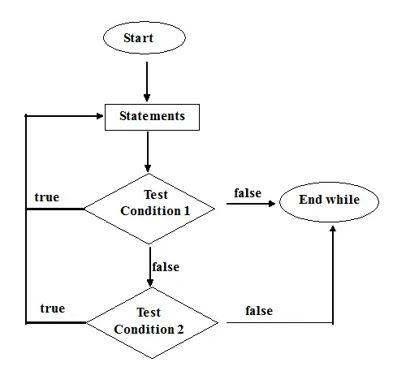
Iterative/Looping Statements in C
Example 6 – Nested do…while
Syntax
do {
do {
statements
} while(condition1);
statements
} while(condition2);

Slide 36
Iterative/Looping Statements in C
#include <stdio.h>
int main()
{
int i =1, j;
printf("Triangle number pattern\n");
do {
j=1;
do {
printf("%d",j);
j++;
} while(j<=i);
printf("\n");
i++;
} while(i<=3);
return 0;
}
Output :
1
12
123

Slide 37
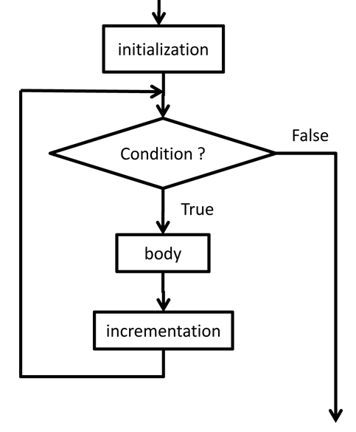

Iterative/Looping Statements in C
The for statement
If the number of times the loop is executed is known – use for
It lets you repeat a statement or compound statement a specified number of times
The body of for statement is executed zero or more times until an optional condition becomes false
Syntax
for ( initialization; condition ; update control variable)
{
statements;
}
statement x;

Slide 38
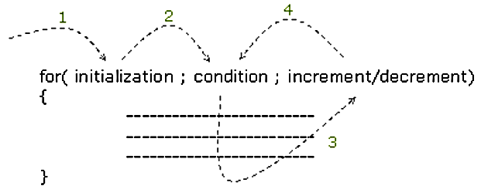
Iterative/Looping Statements in C
Execution of a for statement proceeds as follows
  1. Initialization is evaluated at the beginning of the loop
  2. If the condition evaluates to true(non-zero) the body of the loop is executed. Otherwise the control is transferred to the statement x following the loop body
  3. The control variable is updated at the end of each iteration
  4. Steps 2 and 3 are repeated

Slide 39
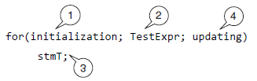
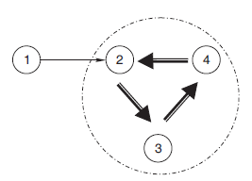
Iterative/Looping Statements in C

Slide 40
Iterative/Looping Statements in C
Printing 1 to 10 natural numbers
/* using while loop */
#include<stdio.h>
int main()
{
int i=1;
while(i<=10)
{
printf("\t%d",i);
i++;
}
return 0;
}
/* using for loop */
#include<stdio.h>
int main()
{
int i;
for(i=1;i<=10;i++)
printf("\t%d",i);
return 0;
}
Output : 1 2 3 4 5 6 7 8 9 10

Slide 41
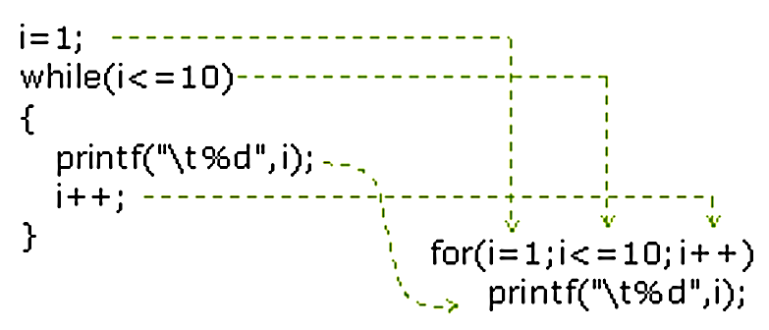
Iterative/Looping Statements in C
Converting while loop into for loop

Slide 42
Iterative/Looping Statements in C
Initially, i=1
I iteration
1<=5 (true)
print 1
i=1+1=2
II iteration
2<=5 (true)
print 2
i=2+1 = 3
III iteration
3<=5(true)
print 3
i= 3+1 =4
IV iteration
4<=5 (true)
print 4
i=4+1=5
V iteration
5<=5 (true)
print 5
i=5+1 = 6
VI iteration
6<=5 (false)
/* using for loop */
#include<stdio.h>
int main()
{
int i;
for(i=1; i<=5; i++)
printf("\t%d",i);
return 0;
}
Initialization :1
Loop condition test :n+1
Update of control variable :n

Slide 43
Iterative/Looping Statements in C
Note :
Initialization, condition, and control variable updation are optional
  Condition (if any) is evaluated. It is evaluated before each iteration.
  If condition is omitted, condition is considered true, a for statement without a condition terminates only when a break or return statement within the statement body is executed, or when a goto (to a labeled statement outside the for statement body) is executed.
A for statement also terminates when a break, goto, or return statement within the statement body is executed
A continue statement in a for loop causes loop-expression to be evaluated
When a break statement is executed inside for loop, loop-expression is not evaluated or executed
The statement for( ;; ); - is the customary way to produce an infinite loop which can only be exited with a break, goto, or return statement

Slide 44
Iterative/Looping Statements in C
Note :
The initialization, loop-continuation condition and increment can contain arithmetic expressions.
  For example, if x = 2 and y = 10, the statement
for (j = x; j <= 4 * x * y; j += y / x)
is equivalent to the statement
for (j = 2; j <= 80; j += 5)
The “increment” may be negative (in which case it’s really a decrement and the loop actually counts downward)
If the loop-continuation condition is initially false, the loop body does not execute. Instead, execution proceeds with the statement following the for statement
The control variable is frequently printed or used in calculations in the body of aloop, but it need not be. It’s common to use the control variable for controlling iteration while never mentioning it in the body of the loop

Slide 45
Iterative/Looping Statements in C
Examples Using the for Statement
int i, j, s;
  for (i = 1; i <= 100; ++i) // for (i = 0; i <100; ++i)
  for (i = 1; i <= 100; i++)
  for (i = 100; i >= 1; i--)
  for (i = 7; i <= 77; i += 7)
  for (i = 20; i >= 2; i -= 2)
  for (j = 2; j <= 17; j = j + 3)
  for (j = 44; j >= 0; j -= 11)
  for (s = 0,i = 1;i <= 10; i++)
  s = s + i;
  scanf("%d",&n);
  for (i = 1;i <= n; i++)

Slide 46
Iterative/Looping Statements in C
#include<stdio.h>
int main()
{
int i;
for( i=1; i<=5; )
printf("\t%d", i++);
return 0;
}
Output:
1 2 3 4 5
#include<stdio.h>
int main()
{
int sum=0,i=1;
for( ; i<=5; i++ )
sum = sum + i;
printf("Sum is : %d", sum);
return 0;
}
Output:
Sum is : 15

Slide 47
Iterative/Looping Statements in C
#include<stdio.h>
int main()
{
int i;
for( i=1; ; i++ )
printf("\t%d", i);
return 0;
}
Output:
1 2 3 …….
(infinite number of times)
#include<stdio.h>
int main()
{
for( ; ; )
printf("Hello World");
return 0;
}
Output:
Hello World …………
(infinite number of times)

Slide 48
Iterative/Looping Statements in C
#include<stdio.h>
int main()
{
int i;
for(i=1;i<=5;i++) ;
printf("%d", i);
return 0;
}
Output:
6
#include<stdio.h>
int main()
{
int sum, i;
for(sum=0,i=1; i<=10; sum+=i, i++) ;
printf("Sum : %d", sum);
return 0;
}
Output:
Sum : 55

Slide 49
Iterative/Looping Statements in C
#include<stdio.h>
int main()
{
int i=1, j=5;
while(j>=1)
{
printf("\n%d\t%d", i , j);
i++;
j--;
}
}
Output :
1 5
2 4
3 3
4 2
5 1
for(i=1,j=5; i<=5; i++, j--)
printf("\n%d\t%d", i , j);
#include<stdio.h>
int main()
{
int i, j;
for(i=1,j=5; i<=5; printf("\n%d\t%d", i, j),i++,j--);
return 0;
}

Slide 50
Iterative/Looping Statements in C
Accept numbers until 0 and print the sum of them
#include<stdio.h>
int main()
{
int sum=0, n;
printf("Enter numbers, give 0 to stop:\n");
scanf("%d",&n);
do {
sum=sum+n;
scanf("%d",&n);
} while(n!=0);
printf("Sum : %d", sum);
}
Output :
Enter the numbers, give 0 to stop..
12
34
56
77
0
Sum of numbers 179
for( sum=0, scanf("%d",&n); n!=0; sum+=n, scanf("%d",&n) );
printf("Sum of numbers %d", sum);

Slide 51
Iterative/Looping Statements in C
Nested for statement
  For statement within another for
  When the dimension of data is more than 1, nested for loop is used
  example: Table of data, matrix
Syntax
  for ( initialization; condition 1; control variable updation)
  {
  for ( initialization; condition 2; control variable updation)
  {
  //body of the inner loop
  }
  }
  statement x;

Slide 52
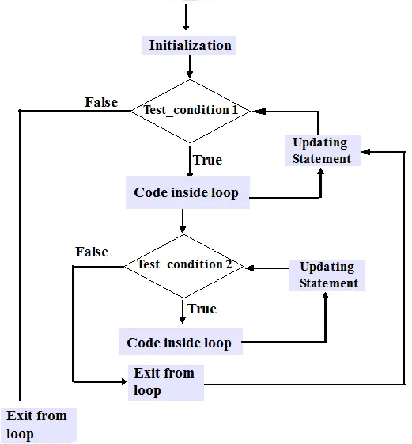
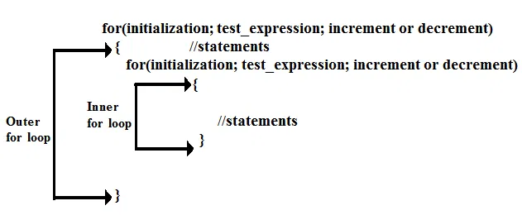
Iterative/Looping Statements in C

Slide 53
Iterative/Looping Statements in C
#include<stdio.h>
int main()
{
int i,j;
for(i=1; i<10; i++)
{
for(j=1; j<=i; j++)
{
printf(“%d”, j);
}
}
}
Output:
1
12
123
1234
12345
123456
1234567
12345678
123456789

Slide 54
Iterative/Looping Statements in C
Initially, i=1
I iteration - outer loop
1<=3 (true)
j =1
I iteration – inner loop
1<=1
print 1
j =1+1=2
II iteration – inner loop
2<=1 (false)
i=1+1 =2
II iteration – outer loop
2<=3 (true), j =1
I iteration – inner loop
1<=2
print 1
j =1+1=2
II iteration – inner loop
2<=2 (true)
print 2
j =2+1 =3
III iteration – inner loop
3<=2 (false)
i=2+1=3
III iteration – outer loop
3<=3 (true), j =1
I iteration – inner loop
1<=3
print 1
j =1+1=2
II iteration – inner loop
2<=3 (true)
print 2
j =2+1 =3
III iteration – inner loop
3<=3 (true)
print 3
j =3+1 =4
IV iteration – inner loop
4<=3 (false)
i=3+1 =4
IV iteration – outer loop
4<=3 (false)
#include<stdio.h>
int main()
{
int i,j;
for(i=1; i<= 3; i++)
{
for(j=1; j<=i; j++)
{
printf(“%d”, j);
}
}
}
Output:
1
12
123

Slide 55
When to Use Which Loop ?
If you know ( or can calculate ) how many iterations you need, then use a counter-controlled ( for ) loop
Otherwise, if it is important that the loop complete at least once before checking for the stopping condition, or if it is not possible or meaningful to check the stopping condition before the loop has executed at least once, then use a do-while loop
Otherwise use a while loop

Slide 56
Unconditional Control Transfer Statements in C
break
continue
goto
return

Slide 57
Unconditional Control Transfer Statements in C
The break statement
Used to terminate the loop in the middle of any iteration when a certain condition is satisfied
Sometimes while executing a loop it becomes desirable to quit the loop as soon as certain condition occurs
For example
  Consider searching a particular number in a set of 100 numbers as soon as the search number is found it is desirable to terminate the loop
The break statement allows us to accomplish this task

Slide 58
Unconditional Control Transfer Statements in C
The break statement terminates the execution of the nearest enclosing do, for, switch, or while statement in which it appears
Control passes to the statement that follows the terminated statement. ie., a break causes the innermost enclosing loop or switch to be exited immediately.
Syntax
break;
Note: Within nested statements, the break statement terminates only the do, for, switch, or while statement that contains it

Slide 59
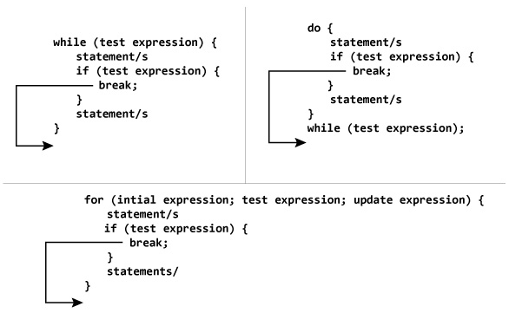
How does break statement work?

Slide 60
Unconditional Control Transfer Statements in C
#include<stdio.h>
int main()
{
int x=1;
while(1) /*infinite loop*/
{
if(x==5)
break;
printf("\t%d",x++);
}
return 0;
}
#include<stdio.h>
int main()
{
int x=1;
for ( ; ; )
{
if(x>5)
break;
printf("\t%d", x++);
}
return 0;
}
Output:
1 2 3 4 5

Slide 61
Unconditional Control Transfer Statements in C
#include <stdio.h>
int main() {
// nested for loops with break statement
// at inner loop
for (int i = 0; i < 5; i++)
{
for (int j = 1; j <= 10; j++)
{
if (j > 3)
break;
else
printf("*");
}
printf("\n");
}
return 0;
}
Output:
***
***
***
***
***
Note: Within nested statements, the break statement terminates only the do, for, switch, or while statement that contains it

Slide 62
Unconditional Control Transfer Statements in C
The continue statement
The continue statement is used to bypass the remainder of the current pass through a loop
The loop does not terminate when a continue statement is encountered. Instead, the remaining loop statements are skipped and the computation proceeds directly to the next pass through the loop
The continue statement can be included within a while, do-while, for statement
Syntax
continue;

Slide 63
Unconditional Control Transfer Statements in C
The continue statement, when executed in a while, for or do…while statement, skips the remaining statements in that control statement’s body and performs the next iteration of the loop
In while and do…while statements, the loop-continuation test is evaluated immediately after the continue statement executes.
In the for statement, the increment expression executes, then the loop-continuation test is evaluated

Slide 64
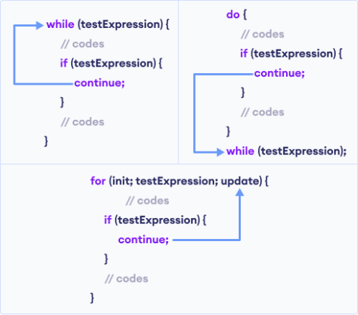
Unconditional Control Transfer Statements in C

Slide 65
Unconditional Control Transfer Statements in C
#include<stdio.h>
int main()
{
int x;
for(x=1;x<=10;x++)
{
if(x%2==1) /*checking for odd number */
continue;
printf("\t%d",x);
}
return 0;
}
#include<stdio.h>
int main()
{
int i;
for(i=1;i<=10;i++)
{
if(i%3!=0)
continue;
printf(“%d”, i);
}
}
Output: 3 6 9
Output:
2 4 6 8 10

Slide 66
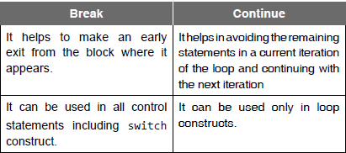
Unconditional Control Transfer Statements in C

Slide 67
Unconditional Control Transfer Statements in C
#include <stdio.h>
int main(void)
{
unsigned int x;
for (x = 1; x <= 10; ++x)
{
if (x == 5)
{ break;
}
printf("%u ", x);
}
printf("\nout of loop at x == %u\n", x);
}
Output: 1 2 3 4
out of loop at x == 5
#include <stdio.h>
int main(void)
{
unsigned int x;
for (x = 1; x <= 10; ++x)
{
if (x == 5)
{ continue;
}
printf("%u ", x);
}
}
Output:
1 2 3 4 6 7 8 9 10

Slide 68
Unconditional Control Transfer Statements in C
The goto Statement – an unconditional branch
The result of the goto statement is a change in the flow of control to the first statement after the label specified in the goto statement
Syntax
goto label;
…
label:
//block of statements
A label is an identifier followed by a colon
A label must appear in the same function as the goto statement that refers to it
It is good programming style to use the break, continue, and return statement in preference to goto whenever possible

Slide 69

Unconditional Control Transfer Statements in C
#include <stdio.h>
int main(void)
{
int count = 1;
start:
if (count > 10)
{
goto end;
}
printf("%d ", count);
++count;
goto start;
end :
return 0;
}
Output:
1 2 3 4 5 6 7 8 9 10

Slide 70
Unconditional Control Transfer Statements in C
#include <stdio.h>
int main()
{
int n, c;
long int f=1;
printf(“\n Enter the number:”);
scanf(“%d”,&n);
if(n<0)
goto end;
c=1;
loop:
f=f*c;
c++;
if(c<=n)
goto loop;
printf(“ FACTORIAL IS %ld”, f);
end:
return 0; }
#include <stdio.h>
int main()
{
int n, c;
long int f=1;
printf(“\n Enter the number:”);
scanf(“%d”,&n);
if(n<0)
goto end;
for(c=1; c<=n; c++)
f*=c;
printf(“\n FACTORIAL IS %ld”, f);
end:
return 0;
}

Slide 71

Unconditional Control Transfer Statements in C
#include<stdio.h>
int main()
{
int i, j;
for ( i = 0; i < 10; i++ )
{
printf( "Outer loop executing. i = %d\n", i );
for ( j = 0; j < 3; j++ )
{
printf( " Inner loop executing. j = %d\n", j );
if ( i == 5 )
goto stop;
}
}
/* This message does not print: */
printf( "Loop exited. i = %d\n", i );
stop:
printf_s( "Jumped to stop. i = %d\n", i );
}

